Slide 1



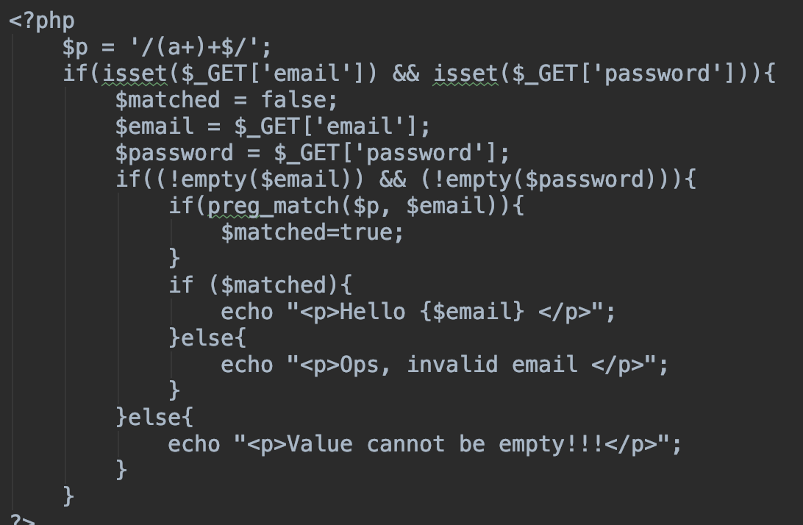
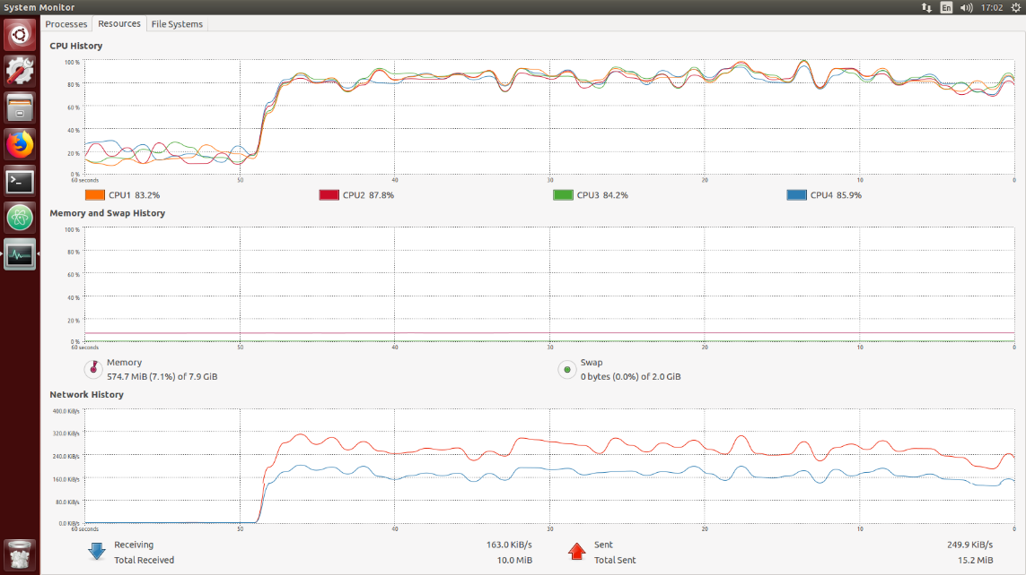
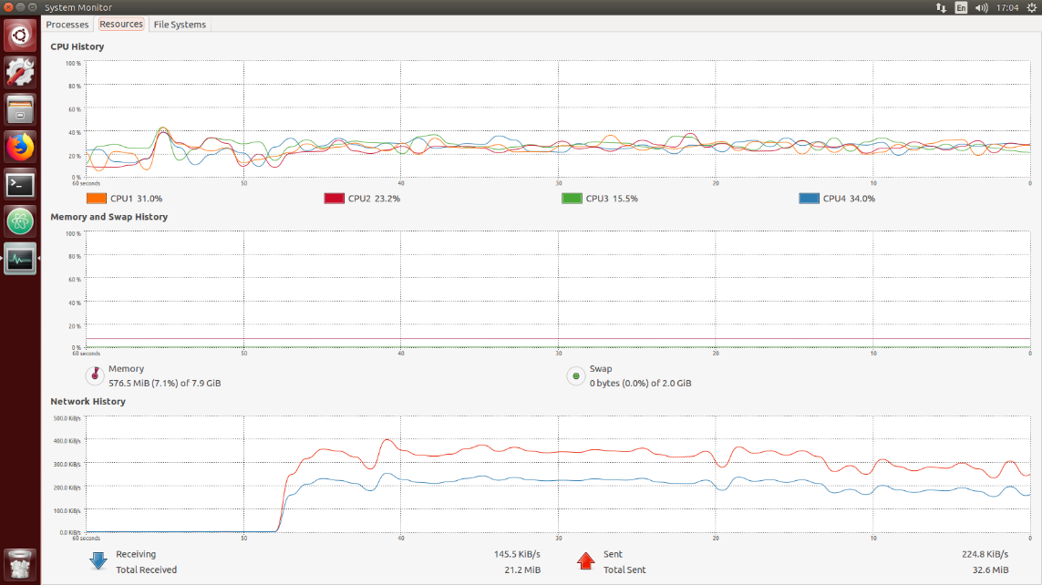

CS5331 Web Security – ReDOS
Group Members – Xiao Yikai, Zhang Xinyue, Huang Kun, Miao Anbang
School of Computing, National University of Singapore
Introduction
Denial-of-Service Attack (DOS Attack) seeks to make resource unavailable to its intended user
Regular Expression Denial of Service (ReDOS) exploits on imperfect implementations using regular expression with special designed patterns, to cause the target to respond very slowly or even temporally not able to provide service to intended users.
Evil Regex is the pattern that may cause this vulnerability. With malicious string, attacker can perform ReDOS to target website because it is using Evil Regex.
Regex Logic & Attack Logic
Objective
Our project aims to identify the logic of Regex checking and its vulnerability of being attacked
Demonstrate how attackers can attack on vulnerable servers and occupy the resources of target machines.
Figure out and verify solutions to this ReDOS attack
Implementation & Results:
Bash script for attack:
Group the following task is sending
Evil Regex Preparation:
Read “email” and “password”
Check “email” using Evil Regex
Return Checking result
Resource Monitoring
Use Linux resource monitoring to observe the result
With Evil Regex Without Evil Regex (Solution)
Solutions
Input Validation (check the length of string before checking Regex): Since the time is increasing exponentially with the length of the string, a possible way of preventing the attack is to filter those long inputs.
Flaw Checking (avoid using vulnerable Regex pattern): It is not possible to avoid using Regex, but it is possible to avoid using Evil Regex patterns. Make sure not using patterns like /(a+)+$/ or some hard to identify ones like /([a-z, 0-9]+)+$/
ReDOS Attack Experiment
Web Server: PHP web server with simple function is deployed. This server simulates a login page and it verifies username input with Evil Regex. Both legal the illegal message will be returned to client who calls it.
Normal Client: Web browser (specifically Firefox) is used as normal client to request.
Vulnerability Detection: Web browser is used to detect the vulnerability by requesting using malicious string.
DOS Attack: A bash script is used to attack server. Requests are sent in group of 1000. New group of requests are sent after the previous group finishes.
Observation: Two observation methods are adopted. One is to observe the resources on the server machine. Another one is to observe response time from a separated request.
Solution Verify: A new PHP web server with solution (avoid using Evil Regex) is deployed. Same ReDOS attack is conducted. And same observations are done.
Conclusion and Future Work
ReDOS Attack can be reproduced on PHP server with vulnerable pattern and string.
We have also tested the Evil Regex pattern and string using other language, namely JavaScript and GoLang. It shows that JavaScript has the same issue but GoLang does not. Future explore can be conducted on different Regex implementation in different language.
Other Application DOS attacks caused by server logic can also be further studied, eg. PHP hash collision.

